Slide 1
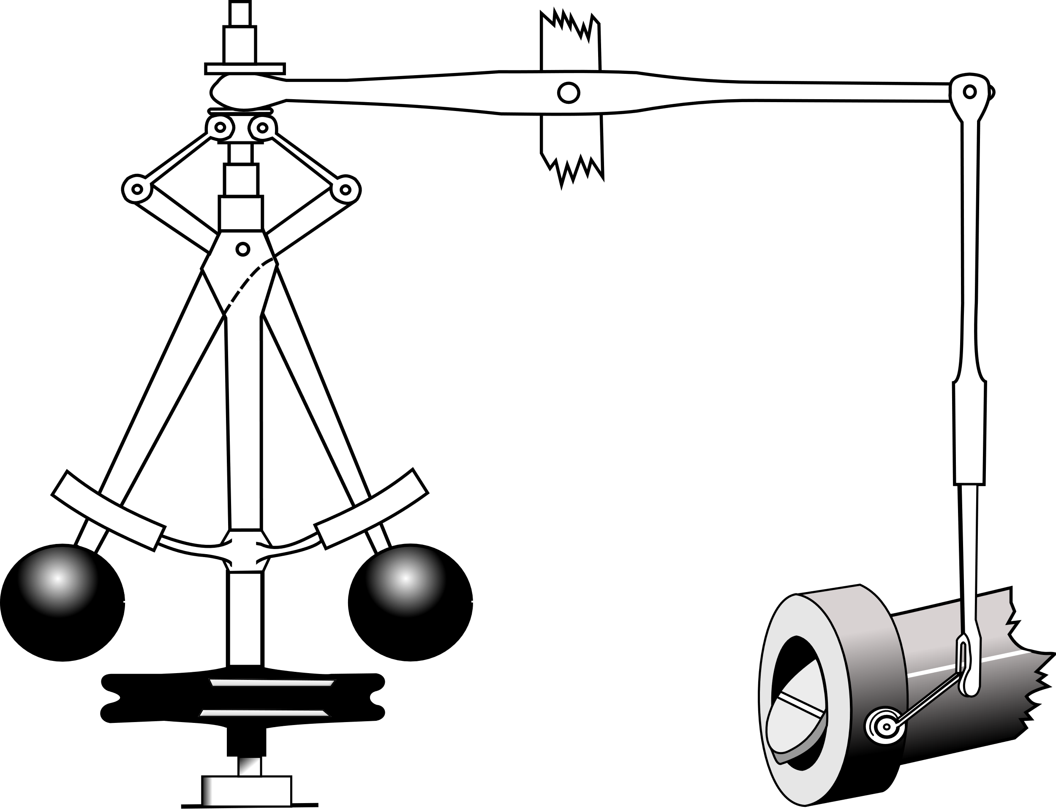
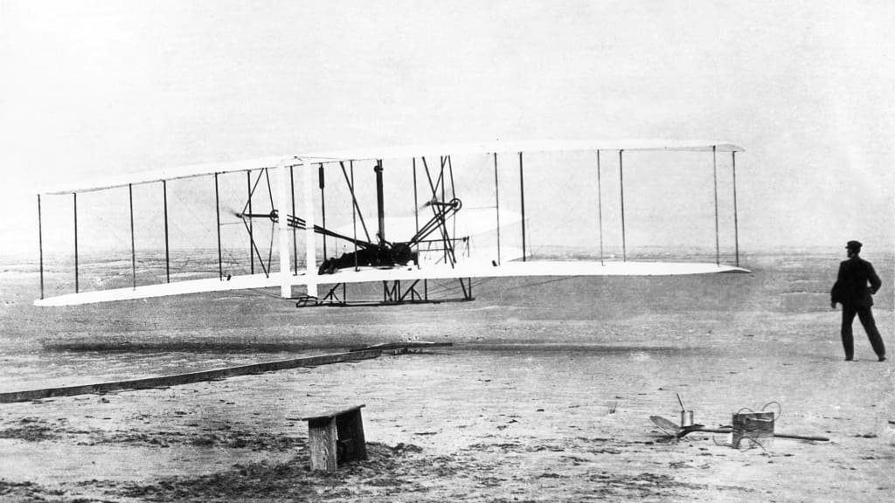
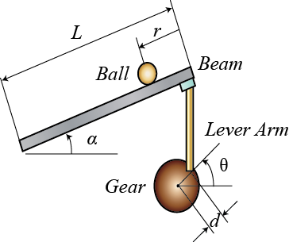
What is “Control”?
Use of feedback to provide stability, performance, robustness
(Traditional)
Credit to Richard Murray, Caltech CDS for some of the ideas in this slide

Slide 2
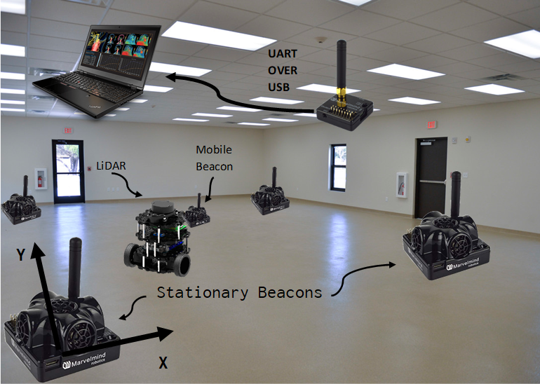
Test Environment
System Architecture

